Slide 1
Week 5
Integrating C# Code to Your XAML Design

Slide 2
C# Recap
Brush up your C# Skills

Slide 3
Which Is The Correct Way To DO ForEach Loop?
foreach (int i = 0; I < array.Length; i++) {//iteration here}
foreach (var item in array) {//iteration here}
for (each item in array) {//iteration here}
for (var &item : array) {//iteration here}

Slide 4
What is List<T>()?
A collection of T type objects which are accessible using index.
A collection of T type key object pairs where the object is accessible using the key.
A collection of objects with different types which are accessible with index.
This thing doesn’t even exist.

Slide 5
Quick Tasks
Showcase how to do a simple if-else
Showcase how to do a simple for loop
Showcase how to do a simple while loop
Showcase how to do a try-catch
Showcase how to create a simple class and utilize it

Slide 6
C# Integration
Put some C# Code to Control the UI.

Slide 7
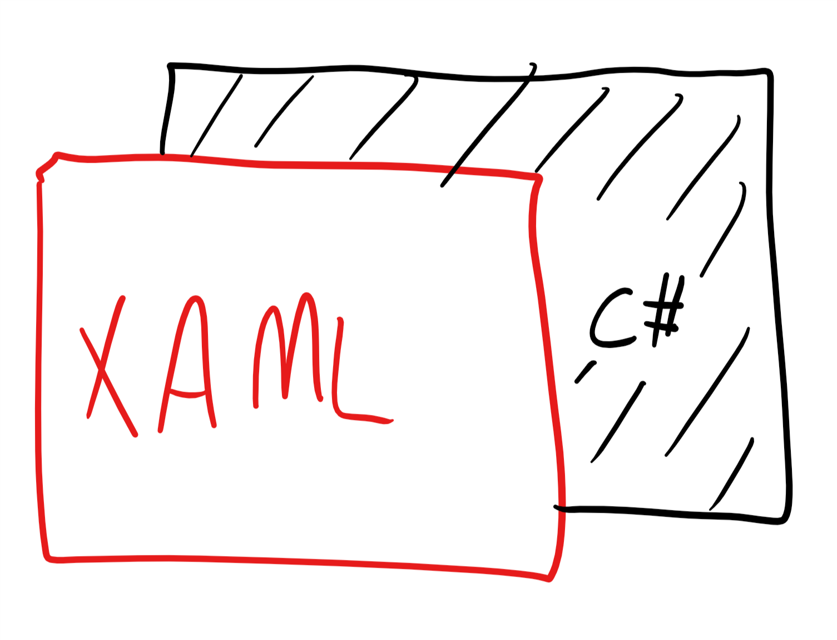
The Concept of Code Behind
Every XAML files that are created in Visual Studio projects comes with a C# file along with it.
The components in XAML file will eventually converted into C# objects, and are able to be consumed in C# code.
Code behind is usually the place where you assign actions to your XAML UI.
Notes:
Show the XAML and C# pair file
Show how components in XAML can be accessible in C#

Slide 8
Accessing XAML Component Properties
Most of the properties in XAML components are accessible in C# since each components are equal to a C# object.
The values of the properties are mostly readable and able to changed directly using the C# code.

Slide 9
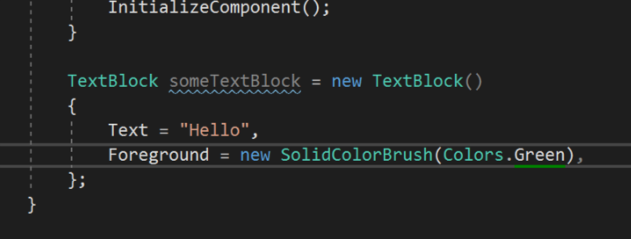
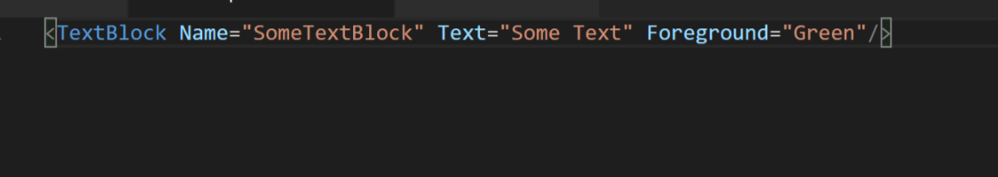
Example XAML > C#

Slide 10
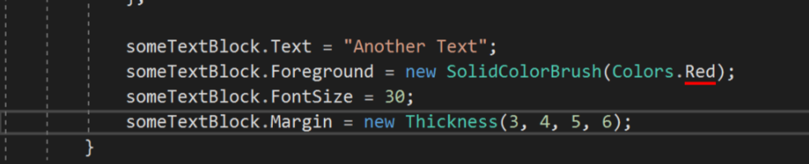
Accessing XAML Properties in C#
Type the name of the component, following with the dot operator to access the properties.
Make sure that the values assign to it matches the object type.

Slide 11
Quick Task
Create a XAML component inside the XAML components, without it properties.
Set the properties of the XAML component using the C# code inside the MainPage() function.

Slide 12
About Events
An event in C# is a way for a class to provide notifications to clients of that class when some interesting thing happens to an object. An event is a mechanism via which a class can notify its clients when something happens. For example when you click a button, a button-click-event notification is sent to the window hosting the button.
In short, when something happens, events tells the software something happens.

Slide 13
Example Events
Button Clicked
Keyboard Pressed
Keyboard Unpressed
Pointer (Mouse) Hover to Component
Pointer (Mouse) Unhover from Component
Page Loaded
Component Size Changed
Task Canceled
More…

Slide 14
Quick Quiz
Which of the following does not look like an event?
Text Changed
Button Clicked
Page Loading
Change Text Color To Red

Slide 15
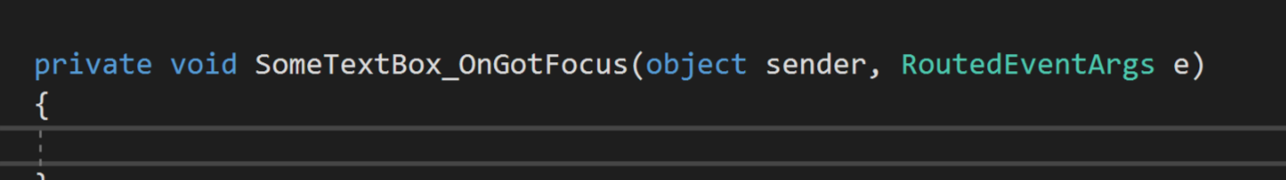
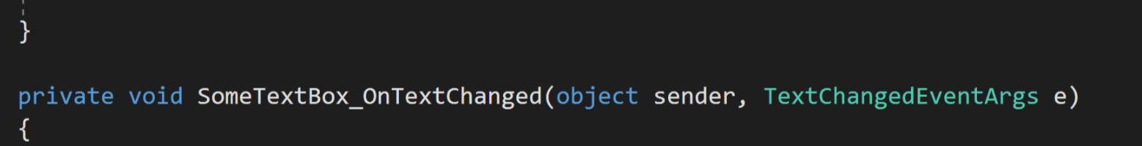
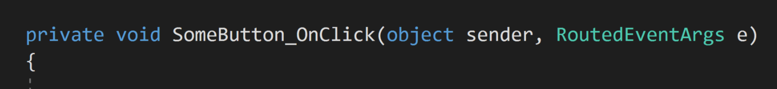
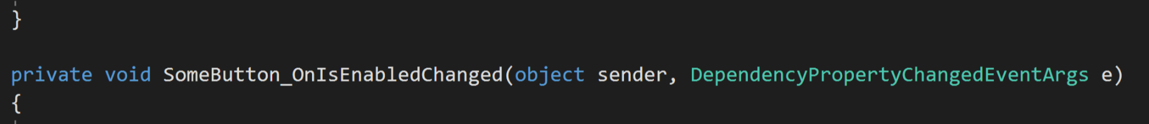
About Event Handler
Event handlers are functions that reacts to an event.
Whenever an event is called, we need a respective event handler to provide action for it.

Slide 16
How To Do Event Easily?
Access the event properties from the XAML component (Can be the Clicked property, can be the TextChanged property or others) Remember to give a name for the component
01
When the auto-suggest prompt you to create a new function, let it do it’s work.
02
Put your actions inside the event handler created in the C# code.
03

Slide 17
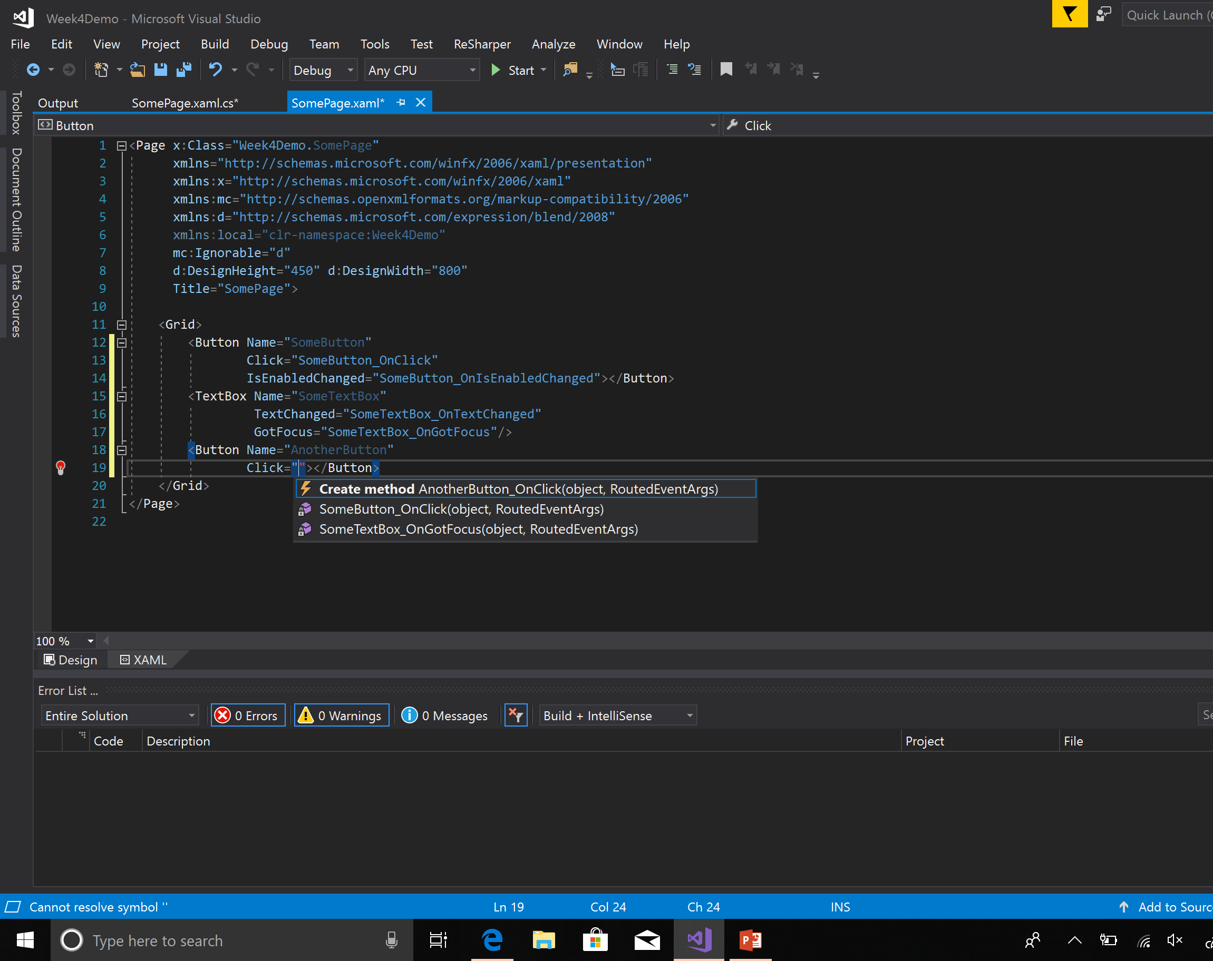
How To Do Event Easily (Pic 1)

Slide 18
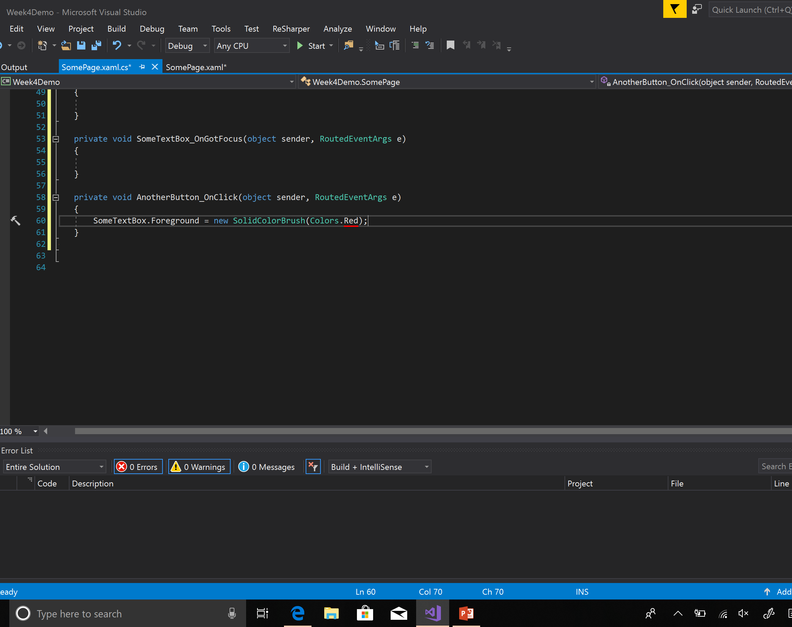
How To Do Event Easily (PIC 2)

Slide 19
Task
Remember the calculator we built last time?
Let’s assign the correct logics for it and make it a real calculator!

Slide 20
Next Week…
How to make different pages in WPF application and how to navigate between them. (One page is definitely not enough to pack all the features right?)

